Slide 1
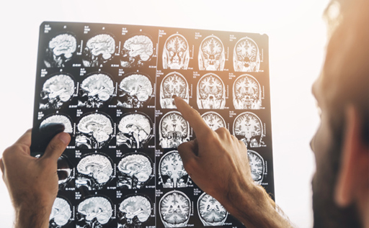
BRAIN TUMOR DETECTION USING DEEPLEARNING
BY
SHARMITHA AR

Slide 2
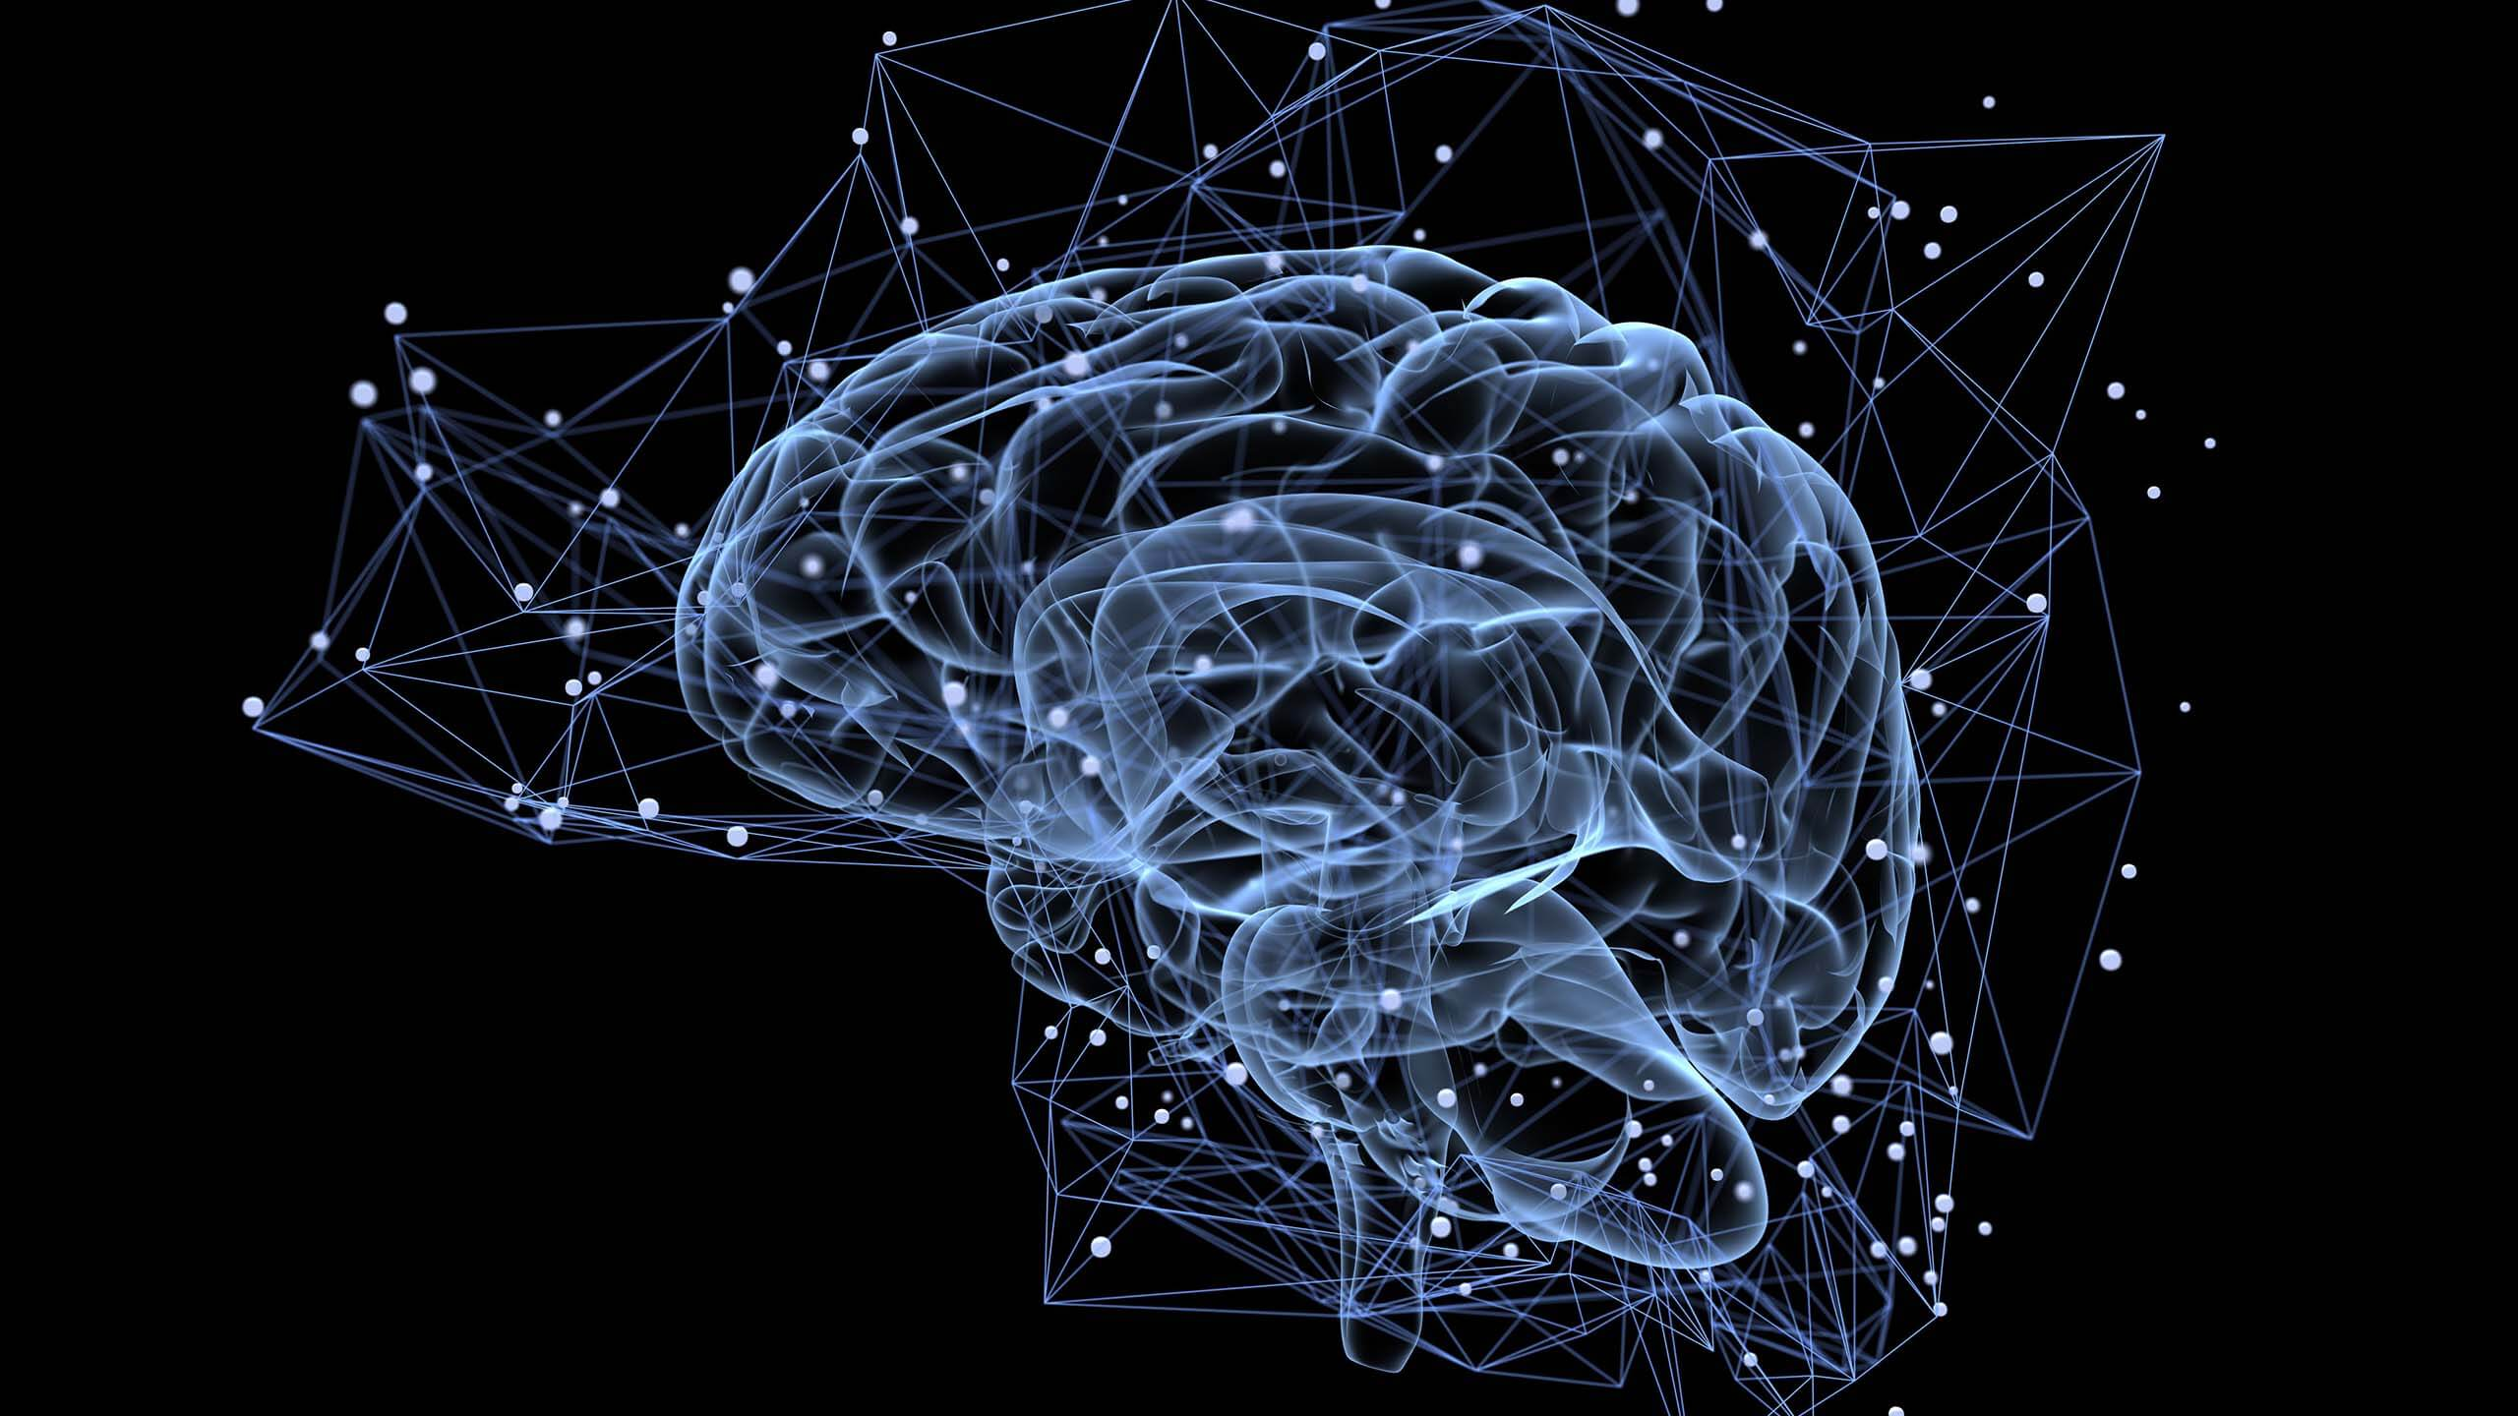
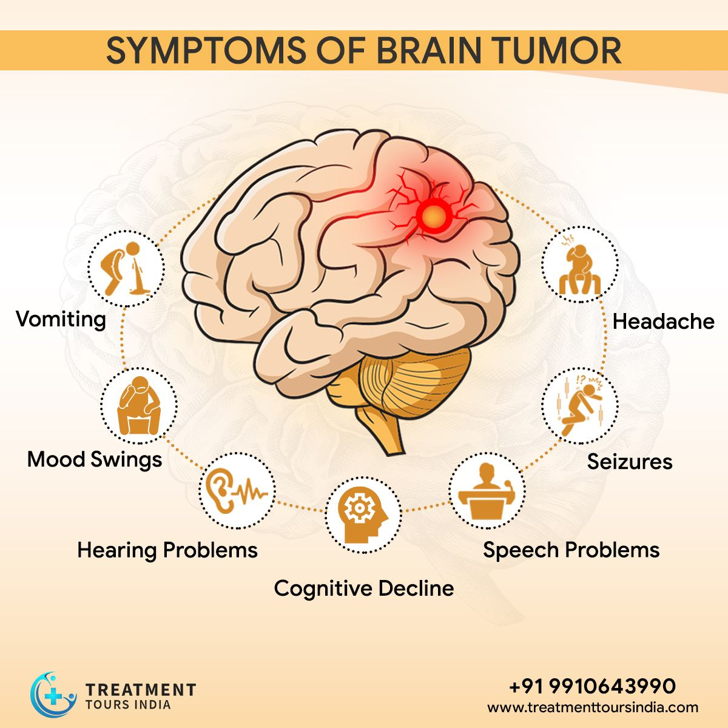
INTRODUCTION
Brain Tumor Detection is a Critical medical task that involves identifying the presence and type of Tumors in the brain.
Traditionally this process has been carried out through various medical imaging techniques such as MRI (Magnetic Resonance Imaging) and CT(Computed Tomography) scans .
However Deep learning a Subset of Artificial Intelligence has emerged as a promising technology for automating and enhancing the Accuracy of Brain Tumor Detection.
Brain tumor are notoriously difficult to detect and classify. Deep learning offers a creative solution to this challenge. It is particularly well-suited for the task due to its ability to analyse large datasets.

Slide 3
Datasets Dataset is taken from Kaggle which contains 3 types of Brain Tumors
Glioma_tumor: It is a type of brain tumor that originates in the glial cells , which are the supportive cells of the central nervous system. Glial cells play a crucial role in providing structural support to neurons and helping them function properly.
Meningioma_tumor: It is a type of tumor that primarily develops in the meninges .Which are the protective members surrounding the brain and spinal card.
Pituitary_tumor: Pituitary tumor are also known as Pituitary adenomas. Are noncancerous growths that develop within the pituitary gland a small, pea-sized gland located at the base of the brain. Despite their noncancerous nature, pituitary tumor can cause a range of health issues by impacting hormone production and the normal functioning of the pituitary gland.
No_tumor:

Slide 4
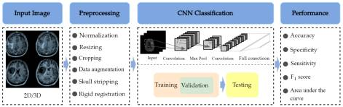
Convolution Neural Network
Convolution neural network (CNN) is a type of Deep learning algorithm that can learn recognize patterns in images by training a CNN on a large dataset of medical images . We can teach it to detect brain tumor with incredible accuracy.

Slide 5
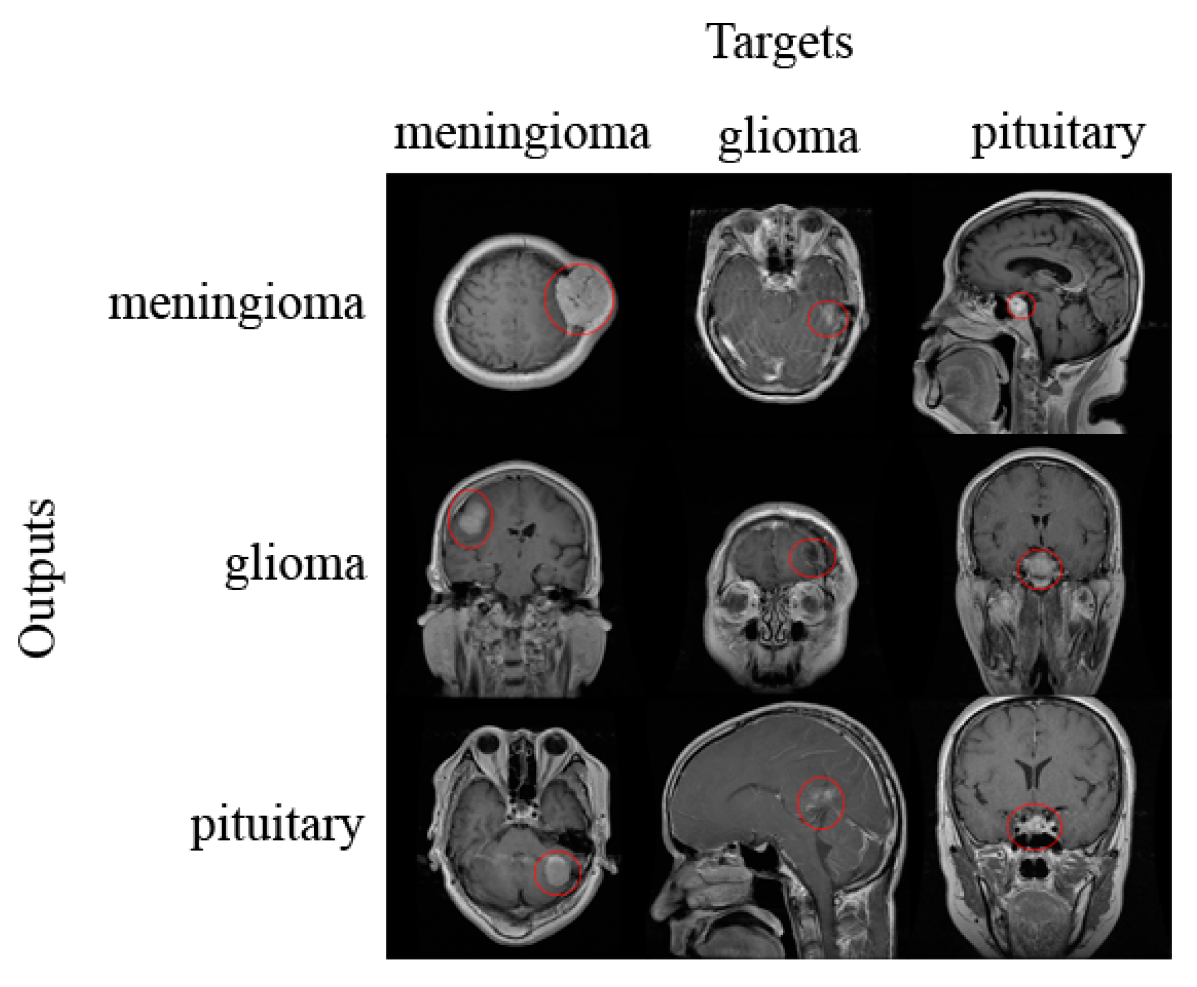
Training a CNN to detect Brain Tumors
Training CNN involves feeding it a large dataset of labeled medical images and adjusting Its parameters to minimize the difference between its predictions and the true labels with enough data and computing power , we can create a highly accurate tumor detection system .

Slide 6
Evaluating Model Performance
Once we trained our CNN, We need to evaluate its performance on a separate dataset of medical Images .
The Feature of Medical image analysis
As deep learning continuous to evolve , we can expect to see even more creative applications in the field of medical images analysis. With advances in hardware and software , we may be able to analyze medical images in real time and provide more accurate diagnoses and treatments.

Slide 7
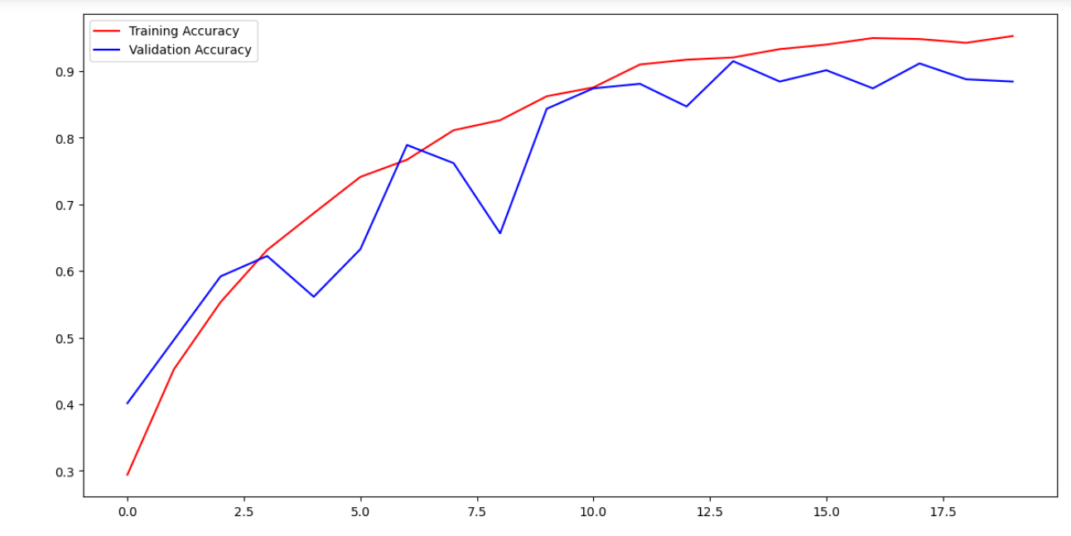
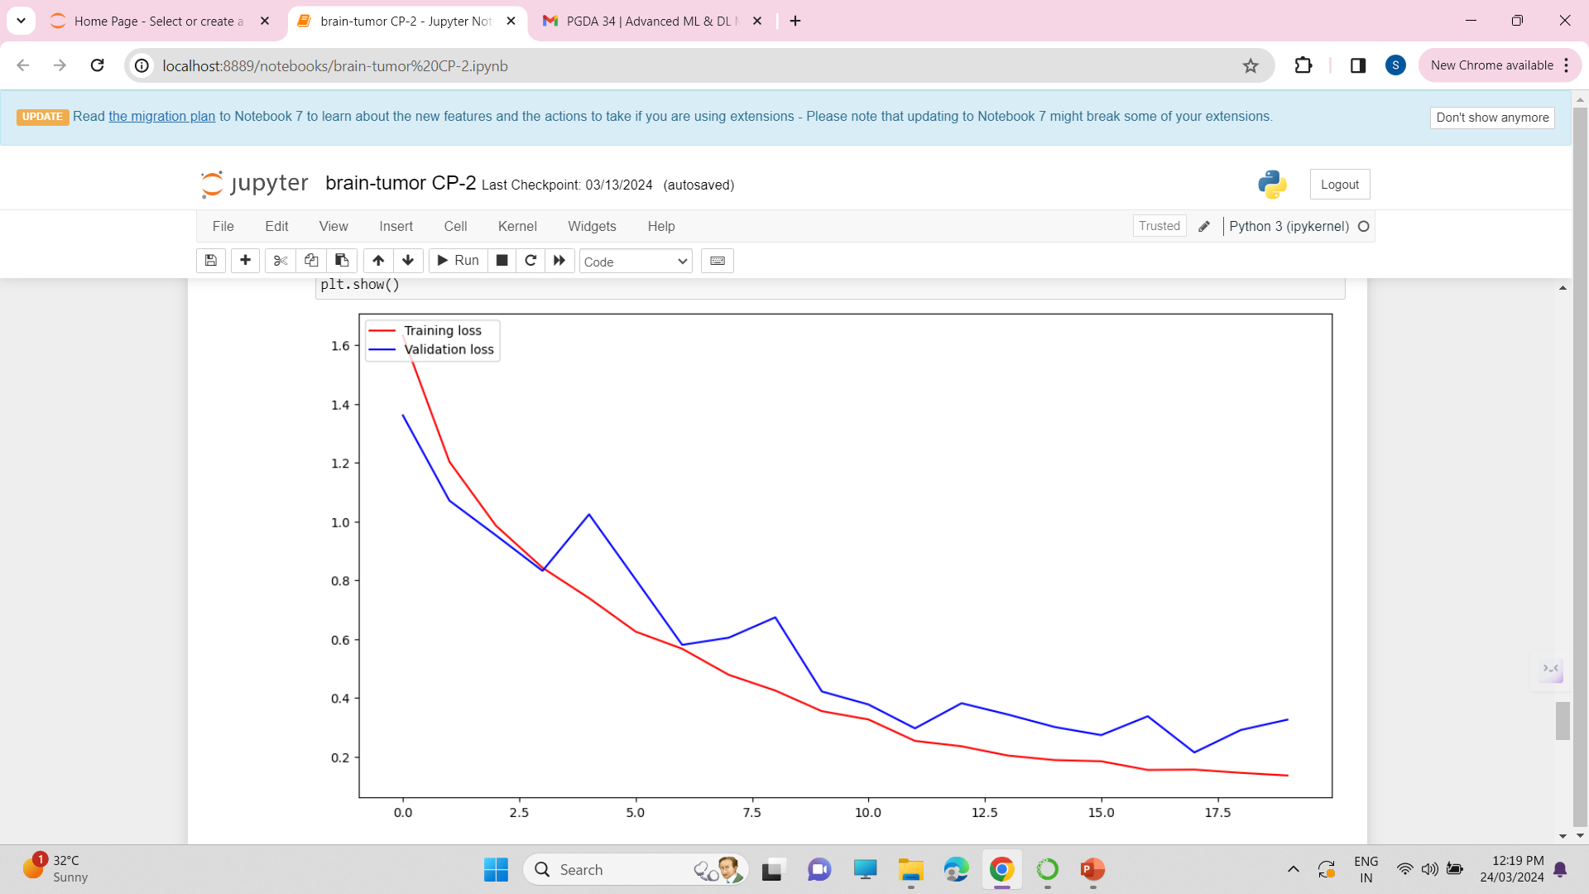
Visualization of Accuracy & loss
Similarly Training and Validation here for both loss is continuously Decreasing in a Good fission.
Training and Validation here for both Accuracy is continuously Increasing in a Good fission.

Slide 8
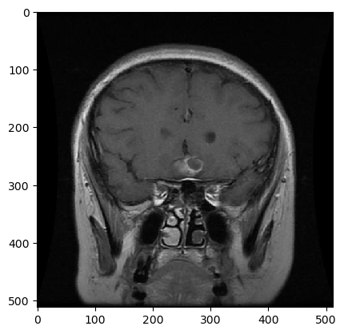
Conclusion
As a result we will be able to predict accurately whether the MRI image shows any tumor or not.
Yes The model has been predicted that it is a Pituitary tumor

